Slide 1

Transforming HR at
International Paper
Operationalizing the Agentic AI Workforce with Anir.io

Slide 2

The Agentic Enterprise Shift
Moving from "Seats" to "Outcomes"
The enterprise landscape is shifting from passive software tools to Autonomous Agentic AI. We are moving from simply creating content (Generative AI) to executing complex work (Agentic AI).

Slide 3

Anir.io: Your AI Workforce Partner
Anir.io does not sell you a software license; we "recruit" digital agents for your team.
•
24/7 Availability: Agents never sleep, ensuring continuous HR operations.
•
Execution Capable: Beyond chat, they execute workflows, process documents, and reason through tasks.
•
Seamless Integration: Native connection to your ERP and HRIS systems.

Slide 4





The 3-Layer Governance Model
Ensuring "Governed Autonomy" across the organization.
Level 1: Owner
Level 2: Company
Level 3: User
The "Super-Ego". Controlled by Leadership (Amine/Khalid). It validates compliance, security, and budgets before any action is taken.
The "Digital Employees". Standardized agents for heavy-lifting processes like Payroll and Recruitment.
The "Co-Pilots". Personalized productivity agents created by employees to handle daily administrative tasks.

Slide 5


Enterprise-Grade Security
Trust is the currency of the AI era.
•
Data Sovereignty: Your data remains yours. It is never used to train public models.
•
End-to-End Encryption: Total security of information flows.
•
Risk Mitigation: The "Owner Agent" acts as an intelligent firewall, preventing hallucinations and data leaks before they happen.

Slide 6



From Policing to Partnering
Yesterday (Pain Point)
Tomorrow (Value Add)
The "Gendarme"
Tech-Enabled Business Partner
HR focuses on policing compliance, checking timesheets, correcting administrative errors, and enforcing rules.
HR architects the AI workforce. They focus on strategy, culture, and human development while Agents handle the transactional work.

Slide 7

Talent Management & Acquisition Cluster
The Recruited Agents
The Human Team
Strategic Sourcing Sentinel
Sentinelle de Sourcing Stratégique
Mounia (Hiring Manager)
Scans the market 24/7, identifies passive talent, and qualifies technical skills before human contact.
Dounia (Talent Management Officer)
Competency Modeling Architect
Focus: Strategy, Culture, Interviewing.
Architecte de Modélisation des Compétences
Analyzes skill gaps in real-time and generates personalized development plans.

Slide 8
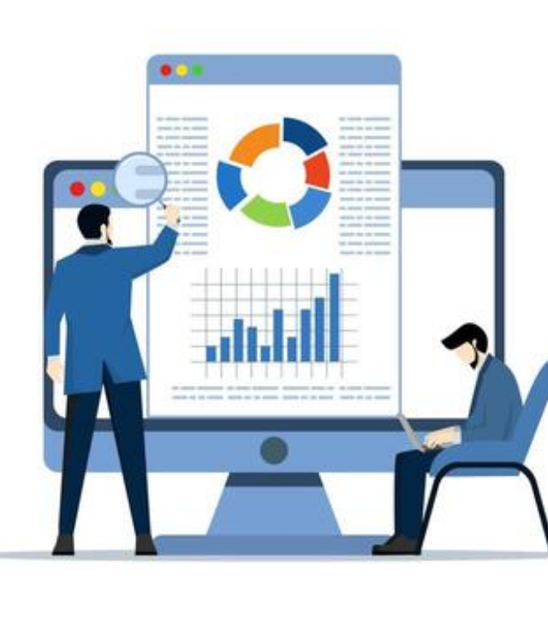

HR Operations & Compliance Core
The Human Team
Adnane & Soukaina (HR Operations)
The Recruited Agent
Payroll Integrity & Fraud Auditor
Auditeur d'Intégrité de Paie et Fraude
"The Watchdog"
Real-time cross-referencing of clock-ins, contracts, and transfers. Detects anomalies (fraud or error) and prepares audit reports without human intervention.

Slide 9
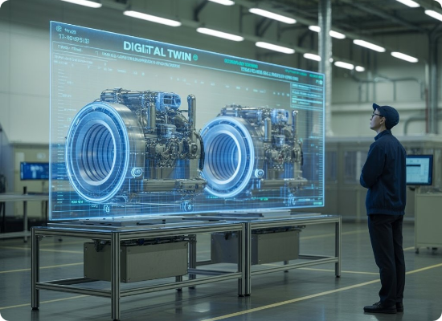

Field HR Business Partnering
The Human Team
Lakhdar, Laila & Ghita (HR Business Partners)
The Recruited Agent
Industrial Relations Concierge
Concierge des Relations Industrielles
Acts as a single point of contact for factory employees. Answers rights questions (leave, sickness), manages level-1 disciplinary admin, and reports "social pulse" analytics to HRBPs.

Slide 10

Strategic Steering & Analytics
The Recruited Agent
The Leadership Team
Organizational Health Monitor
Moniteur de Santé Organisationnelle
Amine (Directeur RH)
Predictive Strategy
Khalid (Expert HR / Data)
Consolidates data from all other agents (Recruitment, Payroll, Climate) to provide Amine and Khalid with strategic predictions (e.g., strike risk, key talent attrition, wage bill drift).
Role: Governance & Strategy

Slide 11
Anir.io
Ready to recruit your AI Workforce?
Transforming HR into Tech-Enabled Business Partners

